Slide 1
Generative Neural Networks
CS 6384 Computer Vision
Professor Yapeng Tian
Department of Computer Science
Slides borrowed from Professor Yu Xiang

Slide 2
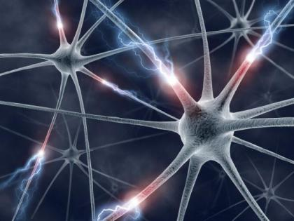
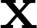
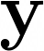
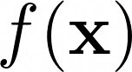
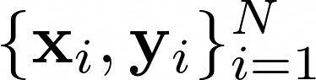
Supervised Learning
Image
Object class
Training Data
Input
Output

Slide 3
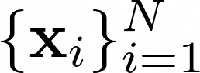
Unsupervised Learning
No label
Training data
Goal: discover some underlying hidden structure of the data
Examples
Dimension reduction
Clustering
Probability density estimation
Generative models

Slide 4
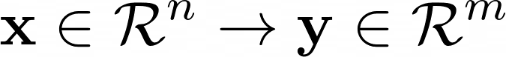
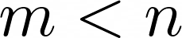
Dimension Reduction
Map data from a high-dimension space to a low-dimension space
The low-dimensional representation maintains meaningful properties of the original data
E.g., can be used to reconstruct the original data
Applications
Data compression, data visualization, data representation learning
Notes:
In machine learning, dimensionality reduction is the process of reducing the number of features that describe some data. This reduction is done either by selection (only some existing features are conserved) or by extraction (a reduced number of new features are created based on the old features)
It can be useful in many situations that require low dimensional data (Data compression, data visualization, data representation learning…).

Slide 5
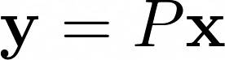
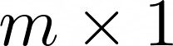
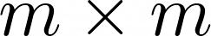
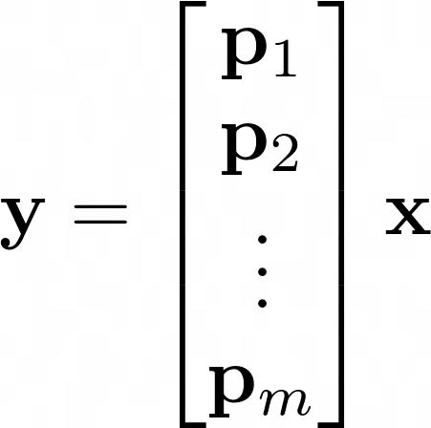
Principal Component Analysis (PCA)
Linear mapping
Rows of P, principal components
Notes:
One of the first methods that come in mind when speaking about dimensionality reduction is principal component analysis (PCA).

Slide 6
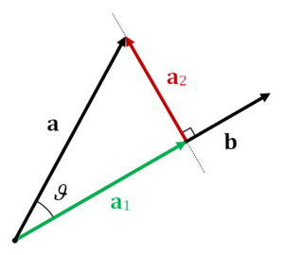
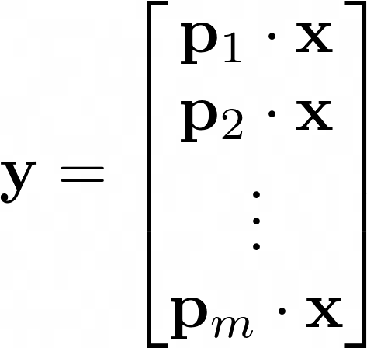
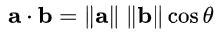
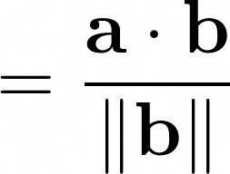
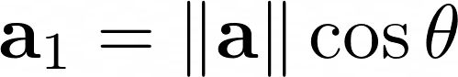
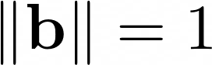
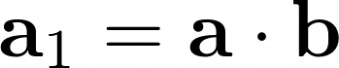
Principal Component Analysis (PCA)
Change of basis
Projection
If

Slide 7
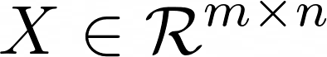
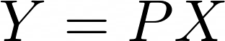
Principal Component Analysis (PCA)
Given a set of data points
Covariance matrix
dimension
# data points
Rows of X

Slide 8

Principal Component Analysis (PCA)
D is a diagonal matrix
E is a matrix of eigenvectors of C_X arranged as rows
The goal of PCA
All off-diagonal terms in should be zero (Y is decorrelated)
Each successive dimension of Y should be rank-ordered according to variance
Solution
The principal components P is the eigenvectors of
A Tutorial on Principal Component Analysis. Jonathon Shlens, 2014
Notes:
We select the matrix P to be a matrix where each row pi is an eigenvector of CX . By this selection, P = E^T. With this relation, We have (P −1 = P T ) we can finish evaluating CY
The inverse of an orthogonal matrix is its transpose. P is an orthogonal matrix.

Slide 9
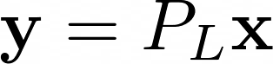
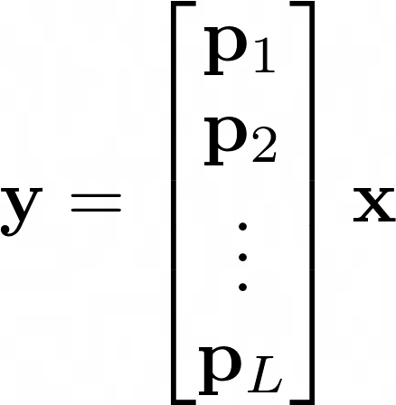
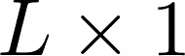
Principal Component Analysis (PCA)
Dimension reduction
Use L < m principal components

Slide 10


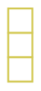
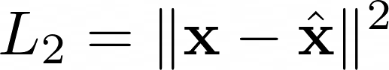

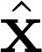
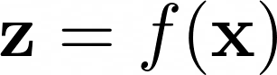
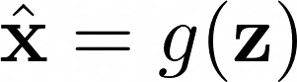
Autoencoder
Use a neural network for dimension reduction
Reconstruction loss function
Encoder
Decoder
Notes:
Let’s now discuss autoencoders and see how we can use neural networks for dimensionality reduction.
The general idea of autoencoders is pretty simple and consists in setting an encoder and a decoder as neural networks and to learn the best encoding-decoding scheme using an iterative optimisation process.
So, at each iteration we feed the autoencoder architecture (the encoder followed by the decoder) with some data, we compare the encoded-decoded output with the initial data and backpropagate the error through the architecture to update the weights of the networks.
Thus, intuitively, the overall autoencoder architecture (encoder+decoder) creates a bottleneck for data that ensures only the main structured part of the information can go through and be reconstructed. Looking at our general framework, the family E of considered encoders is defined by the encoder network architecture, the family D of considered decoders is defined by the decoder network architecture and the search of encoder and decoder that minimise the reconstruction error is done by gradient descent over the parameters of these networks.
In such case, the more complex the architecture is, the more the autoencoder can proceed to a high dimensionality reduction while keeping reconstruction loss low.

Slide 11
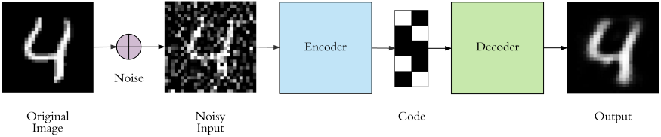
Case Study: Denoising Autoencoder
https://www.analyticsvidhya.com/blog/2021/07/image-denoising-using-autoencoders-a-beginners-guide-to-deep-learning-project/

Slide 12
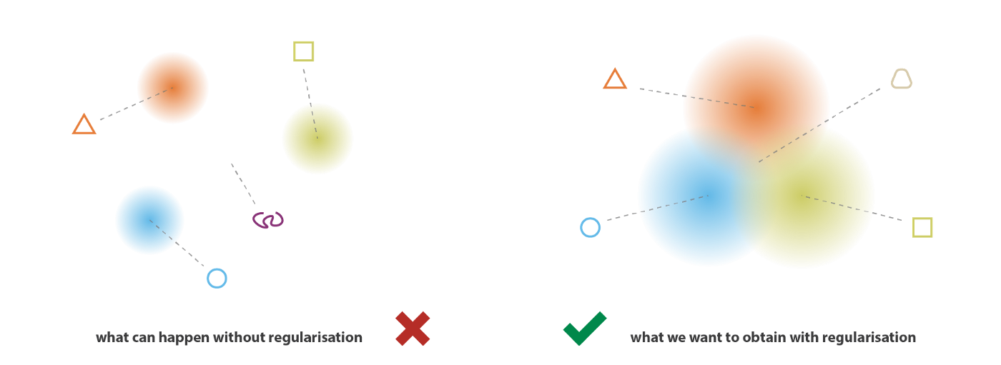
Content Generation
Given a dataset
How to generate new content from the underlying distribution P(x)?
Autoencoder is not suitable for content generation
Encoder
Decoder
The latent space is not regularized. Some latent vectors may generate meaningless content.
Notes:
At this point, a natural question that comes in mind is “what is the link between autoencoders and content generation?”. Indeed, once the autoencoder has been trained, we have both an encoder and a decoder but still no real way to produce any new content.
At first sight, we could be tempted to think that, if the latent space is regular enough (well “organized” by the encoder during the training process), we could take a point randomly from that latent space and decode it to get a new content.
However, the regularity of the latent space for autoencoders is a difficult point that depends on the distribution of the data in the initial space, the dimension of the latent space and the architecture of the encoder. So, it is pretty difficult (if not impossible) to ensure, a priori, that the encoder will organize the latent space in a smart way compatible with the generative process we just described.

Slide 13
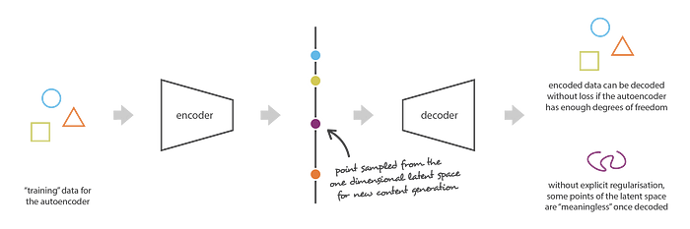
Autoencoder is not suitable for content generation
Irregular latent space prevent us from using autoencoder for new content generation
The latent space is not regularized. Some latent vectors may generate meaningless content.

Slide 14
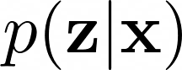
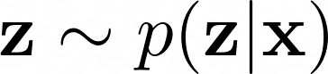
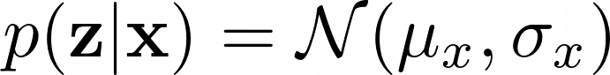
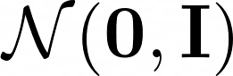
Variational Autoencoder
Introduce regularization to the latent space
Probabilistic formulation
Encoder
Latent distribution
Decoder
Sampled latent
Prior distribution
Notes:
So, in order to be able to use the decoder of our autoencoder for generative purpose, we have to be sure that the latent space is regular enough. One possible solution to obtain such regularity is to introduce explicit regularisation during the training process. a variational autoencoder can be defined as being an autoencoder whose training is regularised to avoid overfitting and ensure that the latent space has good properties that enable generative process.
Just as a standard autoencoder, a variational autoencoder is an architecture composed of both an encoder and a decoder and that is trained to minimise the reconstruction error between the encoded-decoded data and the initial data. However, in order to introduce some regularisation of the latent space, we proceed to a slight modification of the encoding-decoding process: instead of encoding an input as a single point, we encode it as a distribution over the latent space. In practice, the encoded distributions are chosen to be normal so that the encoder can be trained to return the mean and the covariance matrix that describe these Gaussians.
the input is encoded as distribution over the latent space; a point from the latent space is sampled from that distribution; the sampled point is decoded and the reconstruction error can be computed; finally, the reconstruction error is backpropagated through the network

Slide 15
Variational Autoencoder
Latent space
Continuity (close points in latent space decode similar outputs)
Completeness (a sampled latent should generate meaningful output)
https://towardsdatascience.com/understanding-variational-autoencoders-vaes-f70510919f73
Notes:
The regularity that is expected from the latent space in order to make generative process possible can be expressed through two main properties: continuity (two close points in the latent space should not give two completely different contents once decoded) and
completeness (for a chosen distribution, a point sampled from the latent space should give “meaningful” content once decoded).
With this regularisation term, we prevent the model to encode data far apart in the latent space and encourage as much as possible returned distributions to “overlap”, satisfying this way the expected continuity and completeness conditions. Naturally, as for any regularisation term, this comes at the price of a higher reconstruction error on the training data.

Slide 16
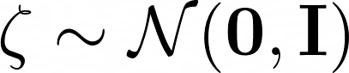
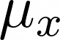
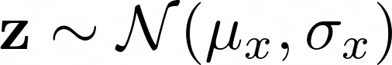
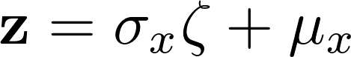
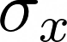
Variational Autoencoder
Reparameterization
Encoder
No gradient
Sampling
Encoder
Not differentiable
Encoder
Notes:
In practice,
zeta

Slide 17
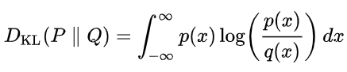
Variational Autoencoder
Encoder-Decoder
Loss function
Encoder
Decoder
Reconstruction loss
Prior loss
Notes:
Zeta

Slide 18
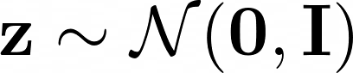
Variational Autoencoder
2D latent space
Generating data
Decoder
Diagonal prior on z -> independent latent variables
Different dimensions of z encode interpretable factors of variation
Auto-Encoding Variational Bayes. Kingma & Welling, ICLR’14.
Notes:
Gaussian form with a diagonal covariance. There is a Diagonal prior on z and elements of z are independent latent variables. Different dimensions of z encode interpretable factors of variation

Slide 19
Direct Content Generation
VAE models the density as
Directly sample from the training distribution without modeling the probability density
Generative Adversarial Networks (GANs) can generate better samples compared to VAEs

Slide 20
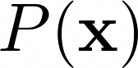
Generative Adversarial Network (GAN)
Goal: sample examples from training distribution
Solution
First sample from a simple distribution (e.g., uniform distribution)
Learn transformation to the training distribution
Output: sample from the training distribution
How to train the generator?
We do not know the mapping from z to training data
Input: random noise

Slide 21
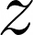
Generative Adversarial Network (GAN)
Generator-Discriminator
Generator
Discriminator
Real?
Fake?
Gradient

Slide 22
Training GAN: Two-player Game
Generator
Generated images
Discriminator
Real?
Fake?
Training images
Discriminator: try to distinguish between real image and fake images (generated images from the generator)
Generator: try to fool the discriminator by generating real-look images

Slide 23
Training GAN: Two-player Game
Minmax objective function
Discriminator output for real data x
Discriminator output for generated fake data
Generator output
Discriminator: maximize the objective such that D(x) is close to 1 and D(G(z)) is close to 0
Generator: minimize the objective such that D(G(z)) is close to 1 (fool the discriminator)
Generative Adversarial Nets. Goodfellow et al. NeurIPS’14

Slide 24
Generative Adversarial Network (GAN)
Visualization of samples from the model
Nearest neighbor from training set
Generative Adversarial Nets. Goodfellow et al. NeurIPS’14

Slide 25
Summary
Autoencoder
Good for dimension reduction, cannot generate new data
Variational autoencoder
Probabilistic formulation
Regularized latent space, can be used to generate new data
Generative Adversarial Network
Directly sample training distribution to generate data
Better samples compared VAEs

Slide 26
Further Reading
A Tutorial on Principal Component Analysis. Jonathon Shlens, 2014. https://arxiv.org/abs/1404.1100
Auto-Encoding Variational Bayes. Kingma & Welling, ICLR, 2004. https://arxiv.org/abs/1312.6114
Autoencoders. Dor Bank, Noam Koenigstein, Raja Giryes, 2021. https://arxiv.org/abs/2003.05991
Generative Adversarial Nets. Goodfellow et al. NeurIPS’14. https://arxiv.org/abs/1406.2661
UNSUPERVISED REPRESENTATION LEARNING WITH DEEP CONVOLUTIONAL GENERATIVE ADVERSARIAL NETWORKS. Radford et al., ICLR’16. https://arxiv.org/abs/1511.06434

